Slide 1

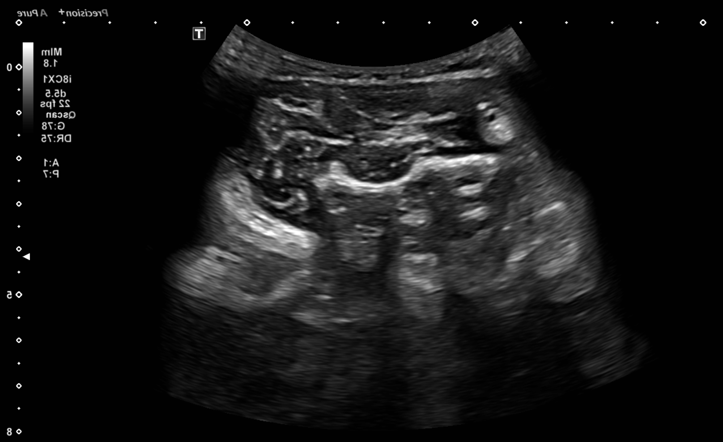
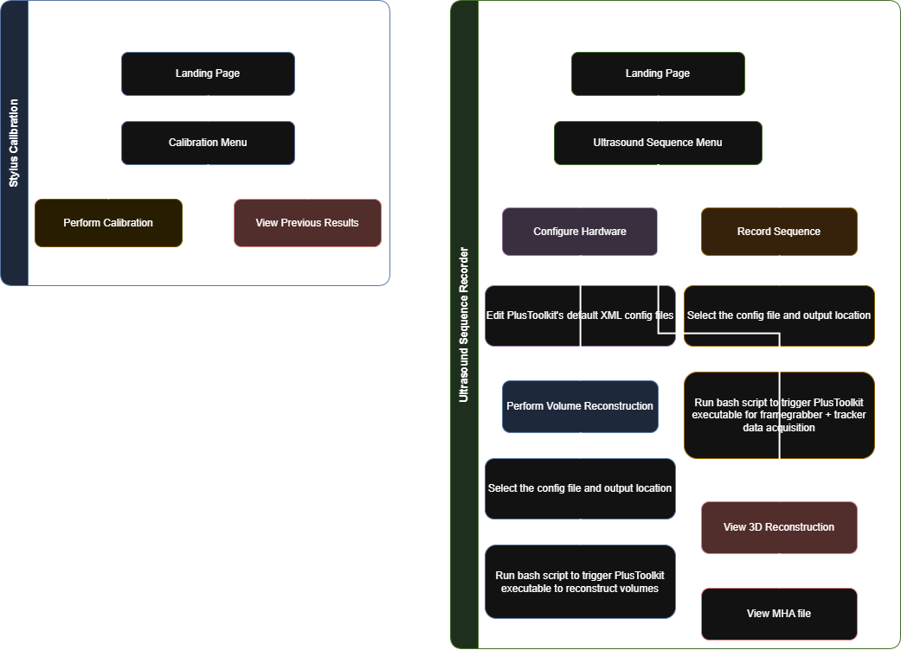
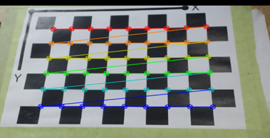
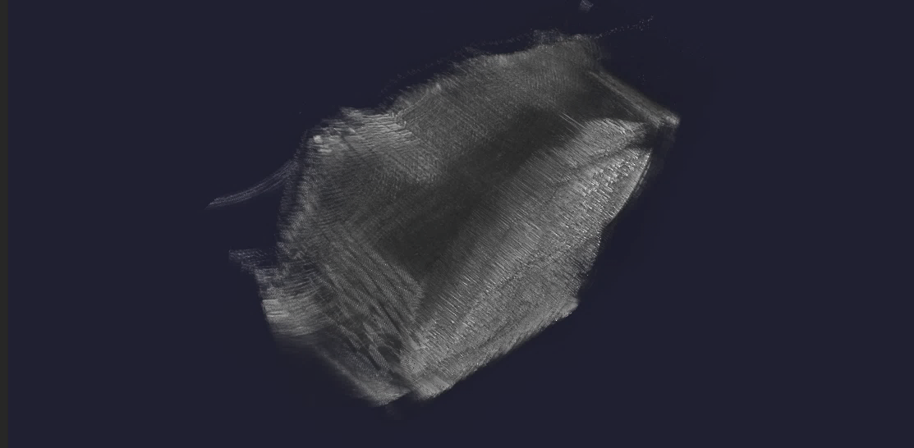
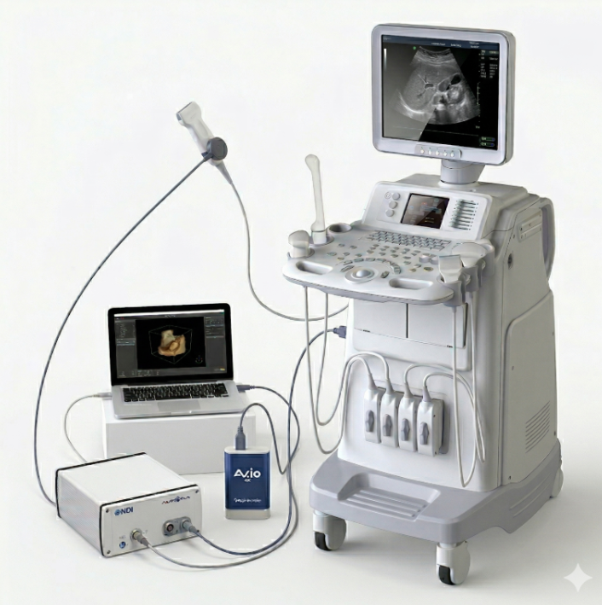
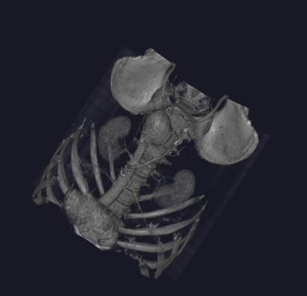
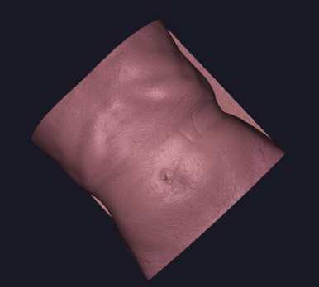
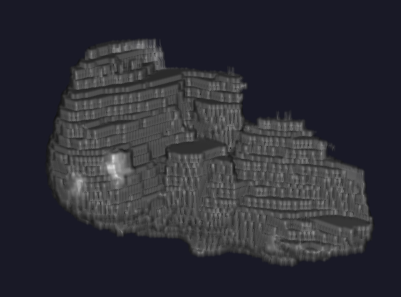
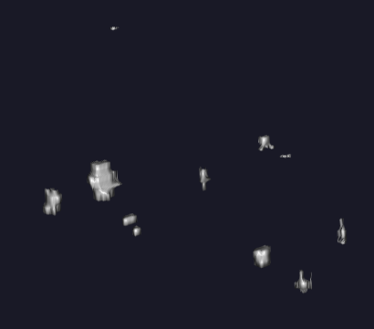
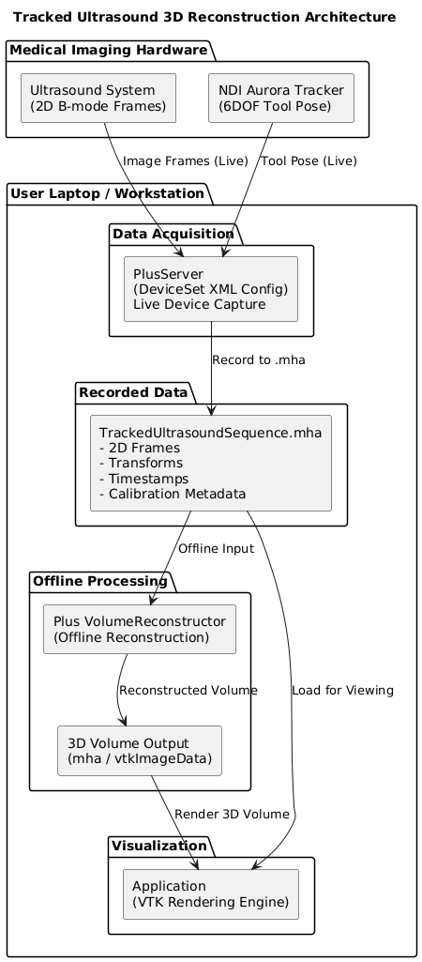
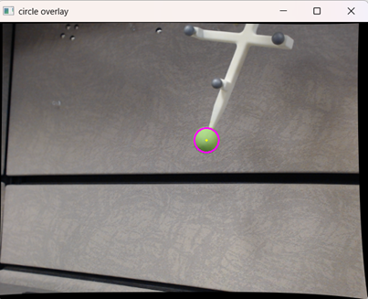
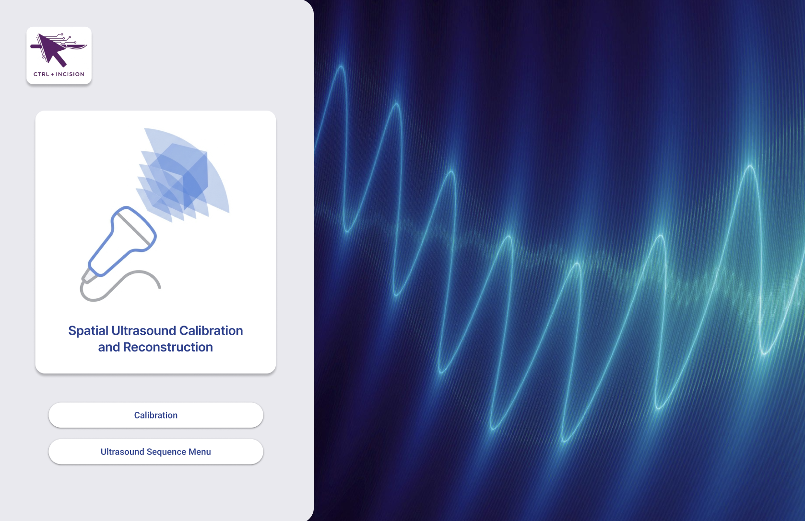
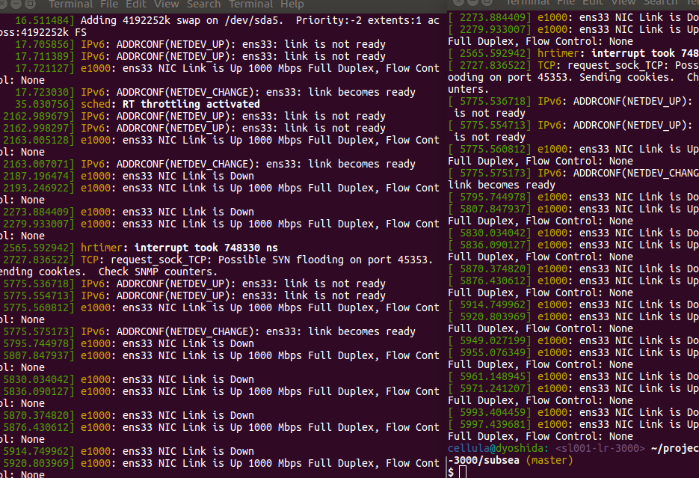
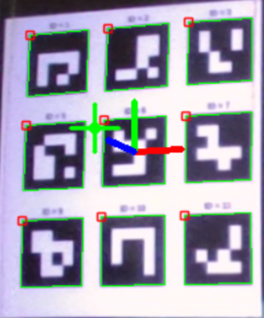
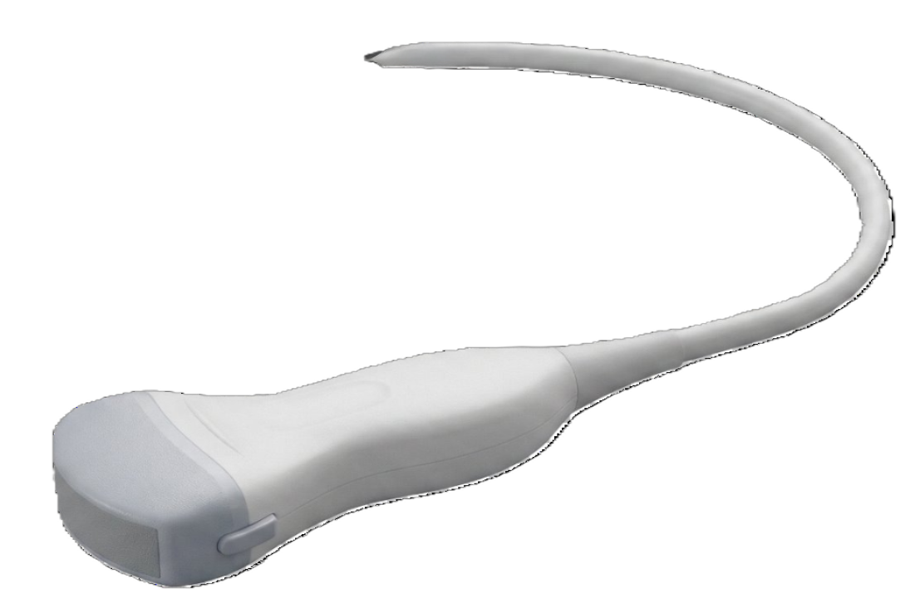
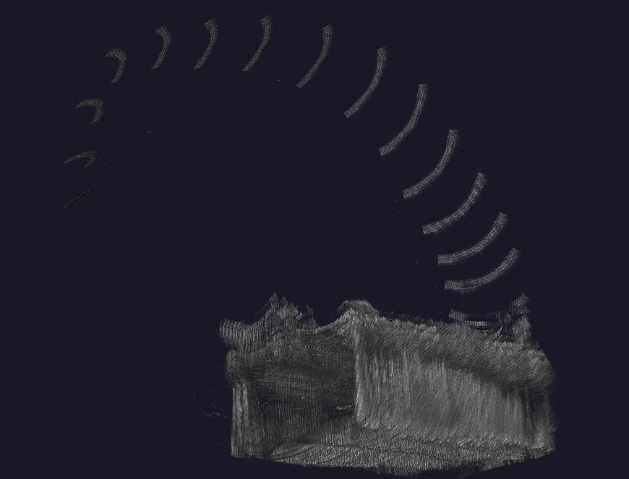



CTRL + Incision – Medical Imaging Scan to 3D Volume Pipeline
Muneeb Asif, Elise Drouillard, Delaney McLachlan, Janki Patel, Hannah Taylor
Western University, London, ON, Canada
Introduction
Methods
Results
System Architecture
Hardware
Software
Code Flow Diagram
Calibration Module
Stylus Calibration
Checkerboard corner detection
Camera parameters estimated
Lens distortion corrected
Axial Calibration
This method identifies the center of the stylus ball by rotating it around a fixed point.
Pivot Calibration
Estimates offset of tracked stylus body and physical tip by rotation around a fixed point
Hand-eye Calibration
Computes transform between tracker and camera for accurate live camera-image overlay
ArUco Stylus Tracking
Results
Successful .mha generation, validated using 3D Slicer
Support for multiple I/O devices
3D Remodeling of multiple types of scans, such as CT, MRI, ultrasound
Transfer functions to apply colour filters and density scaler
Next Steps & Future Directions
Refine Transform Matrix: Precise calibration for spatial accuracy.
Integrated AR View: Calibrated stylus and volume tracking combined.
Dynamic Target Visualization: Real-time stylus guidance relative to anatomy.
Clinical Accuracy Studies: Performance validation in phantom models.
Ultrasound Wand
2D Image stream.
2D Frame Limitations:
NDI Aurora Tracker
Spatial coordinate system.
Hard 3D mental reconstruction.
Misses surrounding structure views.
Costly, bulky, specialized software.
3D Reconstruction Solution:
Precise frame coordinates.
Coordinated surgical guidance.
Lightweight, customizable, open-source alternative.
Figure 1: Calibration Code Flow
Figure 3: Torso CT Scan Rendering
Frame Grabber
Combines tracking data with images.
Motivation
Software Bridge: Simplified UI replaces complex terminal-based scripts.
Research Access: Low-cost, open-source alternative to clinical suites.
Modular Control: Direct hardware access without software "bloat".
Efficiency: Streamlined "Calibrate -> Acquire -> Reconstruct" pipeline.
Figure 4: Liver with Tumours Transfer Function
ArUco markers are detected live to estimate marker pose used for axis rendering and real-time tracking
Figure 2: Ultrasound Sequence to 3D Volume Flow
Figure 5: Phantom Scan Recorded Quickly
School of Software Engineering

